Slide 1
Interim Project Presentation Mobile Anchor Assisted Localization in Wireless Sensor Network B.Tech CSE

Slide 2
Group Details
Sl.No. | Reg. No. | Name of the student | Department
1 | 17ETCS002015 | Aishwarya | CSE
2 | 17ETCS002017 | Akash Sikarwar | CSE
3 | 16ETCS002125 | Shubham Pandey | CSE
4 | 16ETCS002110 | Samprash Jain | CSE
Batch : FET-17

Slide 3
Title of the Project
Mobile Anchor Assisted Localization in Wireless Sensor Network
Supervisor
Project Supervisor : Ms. Vaishali R Kulkarni
Place of Work: RAMAIAH UNIVERSITY OF APPLIED SCIENCES

Slide 4
Outline
Introduction
Motivation(Project Concept and its relevance)
Aims and Objectives
Title, Aim, Objectives, Methods and Methodology
Problem Solving
Project Concept, Design, Implementation
Project Costing
Expected outcomes
Workload Allocation
Updated Gantt chart with separate coloring for completed work
References
Demonstration (If applicable)
Team Experience

Slide 5
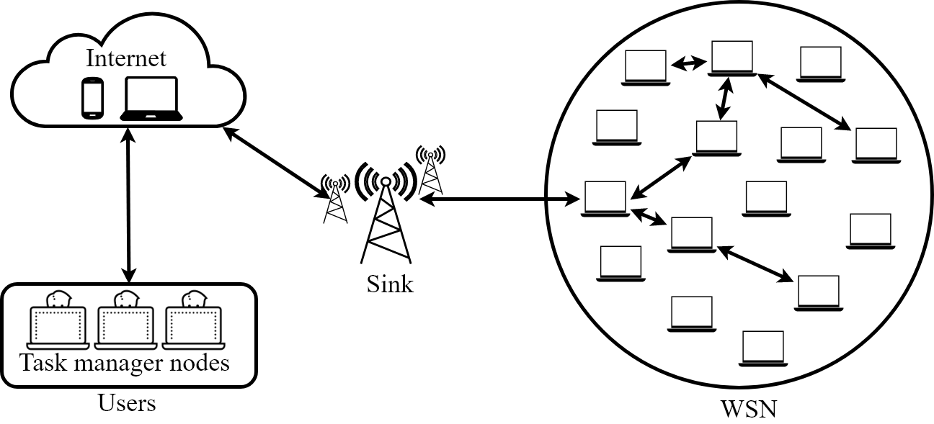
Introduction
Wireless Sensor Network (WSN) is a network of a set of physically small sensor nodes deployed in a given monitoring area, in structured or unstructured environments, to accomplish tasks such as surveillance, monitoring and detection etc.
Figure 1 : Wireless Sensor Network

Slide 6
Motivation
The location of sensor is a critical factor. Any emergency services can be made available, provided its location is known. For example, fire brigade service can be sent if its location of fire is known.
The localization process estimates the sensor location.
Development of low cost, energy efficient and reliable localization algorithms is important in several applications of WSN.
Although GPS provides accurate positioning, the limitation for it is high cost energy consumption which makes it impractical to install on every sensor. Also GPS signals are interrupted in scenarios with deep shadowing effect.

Slide 7
TITLE: Mobile Anchor Assisted Localization in Wireless Sensor Networks
AIM: To develop a localization algorithm for static sensor nodes using a MA. The aim of the project is to reduce number of beacons and localize as many unknown nodes as possible in WSN.

Slide 8
OBJECTIVE
The objective of our project are :
To survey existing literature on the trajectories available.
For detection: simulation of the trajectories available.
Localize dumb nodes using the method called trilateration.
To compare trajectories on the basis of –
Time taken for detection of dumb nodes.
Number of dumb nodes detected.
Localization error

Slide 9
Methods and Methodology
To do literature survey on the available trajectories and challenges for mobile anchor assisted localization in WSN.
1.1 Current trajectories
1.2 information collection about the issues in localization of the mobile sensors.
2. To implement and test the simulations.
2.1 MATLAB used for implementation.
2.2 Test Scenarios with known data.
2.3 Test Scenarios with unknown data

Slide 10
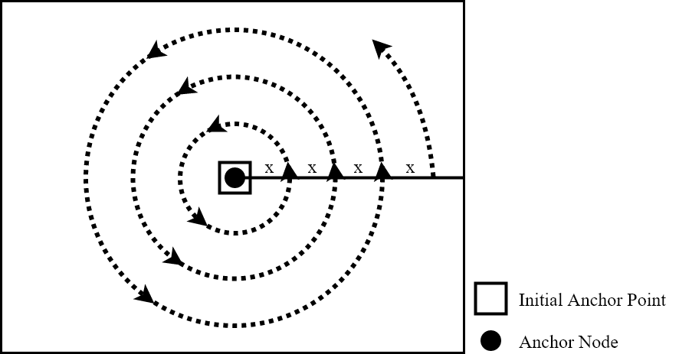
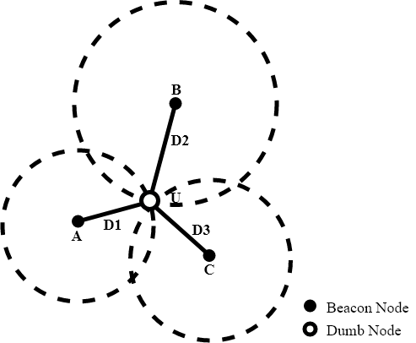
Methods and Methodology
2.4 Trajectories to be simulated
Scan
Double Scan
Hilbert Scan
Random
Circular
3. Localize dumb nodes using the
method called trilateration.
Figure 2 : Circular Trajectory
Figure 3 : Trilateration

Slide 11
Methods and Methodology
To perform comparative analysis of the trajectories implemented.
4.1 Number of nodes detected by the trajectories developed.
4.2 Time taken for the developed trajectories to find dumb nodes.
4.3 Total errors found in the localization by the trajectories developed.

Slide 12
Problem Solving
Project Concept
To localize the dumb nodes with the help of mobile anchor moving in specific trajectory.
On the basis of results, selection of trajectories for different user requirements.
Design
It is basically the trajectories which we are performing for localization
Random
Scan
Double Scan

Slide 13
Implementation
Random
First select a random position.
Traverse to the position.
Check if any dumb node is in range of mobile anchor.
If yes, calculate the distance between dumb node and mobile anchor.
Then, perform again from step 1 for limited number of iterations.

Slide 14
Implementation
Scan
First anchor moves vertically upward.
Then horizontally left to right.
Afterwards, anchor moves vertically downward.
After every hop, Check if any dumb node is in range of mobile anchor.
If yes, calculate the distance between dumb node and mobile anchor.
Then, perform again from step 1.

Slide 15
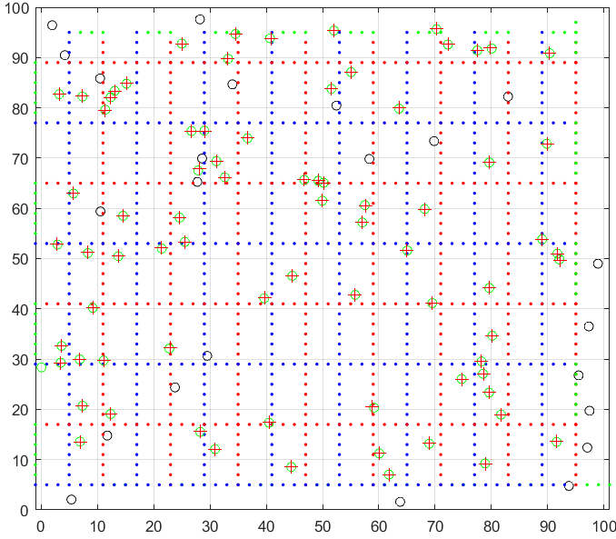
Implementation
Double Scan
First “Scan” is performed.
Then anchor moves horizontally leftward.
Then vertically upward.
Afterwards, anchor moves horizontally towards right.
After every hop, Check if any dumb node is in range of mobile anchor.
If yes, calculate the distance between dumb node and mobile anchor.
Then, perform again from step 2.

Slide 16
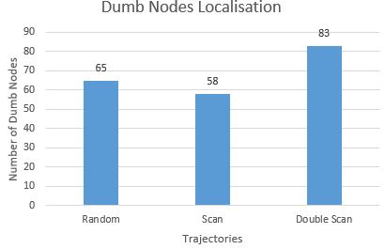
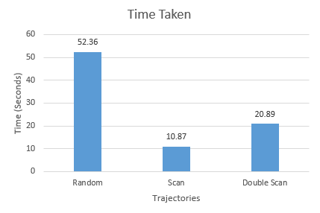
Results
Number of Dumb nodes localized
From the graph, on an average Double Scan is able to localize 83 dumb nodes which comparatively higher than other trajectories.
Time taken in trajectory simulation
From the graph, on an average Scan takes 10 to 11 seconds for localization which is least among all trajectories.

Slide 17
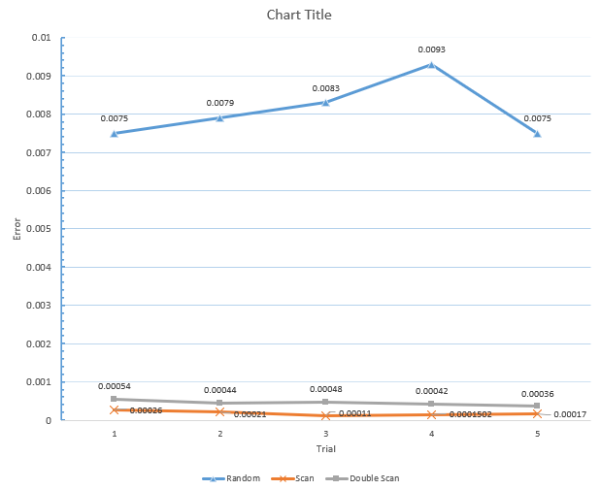
Results
Error in localized dumb nodes
From the graph, on an average localization using Scan yields least error while Random yields the maximum.
But from previous results of number of dumb nodes localized and time taken, Double Scan is performing better than other trajectories.

Slide 18
Expected Outcomes
Demonstration of Working Model
Paper/Book chapter publish.
A New better and faster trajectories

Slide 19
Project Cost Estimates
MATLAB : 0
Computer : 0
Man Power Charges : 10000 * 4
Miscellaneous : 2000.0
____________________________
Total Cost : 42,000.00

Slide 20
Work Load Allocation
 | Aishwarya | Akash | Samprash | Shubham
Objective 1 (Literature Survey)
Objective 2 (Simulation)
Objective 3 (Localization)
Objective 4 (Comparison)

Slide 21
Updated Gantt Chart
Project Work (UG) 10 weeks
Week | 1 | 2 |  | 3 | 4 |  | 5 |  | 6 |  | 7 |  | 8 | 9 | 10
Major Activities
Literature Survey
Trajectory Simulation
Localization
Comparison
Validation
Documentation

Slide 22
References
Dimitrios Koutsonikolas Saumitra M. Das Y. Charlie Hu, School of Electrical and Computer Engineering Center for Wireless Systems and Applications Purdue University, West Lafayette, IN 47907{dkoutson, smdas, ychu}@purdue.edu
Guangjie Han·Huihui Xu·Trung Q. Duong· Jinfang Jiang·Takahiro Hara, Localization algorithms of Wireless Sensor Networks

Slide 23
Demonstration

Slide 24
Team Experience
Get to know about deeper functionality of MATLAB.
Get to know about Wireless Sensor Networks.
Get to know about Localization with different algorithms.
Experience in Group Project.
Experience in Work load distribution.

Slide 25
Thank You

